Slide 1
Which is the best neighborhood to open a Japanese restaurant in Houston?
November 2020
Malú A. S. Vasconcellos

Slide 2
Introduction
1.1 Background
Ariana is from Houston but used to work as a manager at a Japanese restaurant in New York. After 5 years her mother retired and asked Ariana to come back to Houston so they can open their own business with the money from her retirement. Ariana went back to Houston and as she had experience and knew a lot about Japanese food, they decided to open a Japanese restaurant in Houston.
1.2 Problem
From all of her experience, Ariana knew that location is one of the main factors that affects a restaurant performance and neighborhoods with more venues around it would have more people transiting so they would have more customers and if a neighborhood does not have other Japanese restaurant it would be even better. The problem is, as she was away for 5 years she didn’t know anymore which is the best spot in the city to open a restaurant.
1.3 Interest
Ariana and her mother want their own business to not depend on the government’ financial help or just Ariana’s wage. Also, Houston would have one more option of Japanese restaurant.

Slide 3
Data acquisition and cleaning
2.1 Data sources
The data that will be used to identify which neighborhood has more venues will be a table from Wikipedia containing all neighborhoods from Houston until 12/31/2019. The coordinates of all neighborhood will be given by Geopy code. The venues (kind and frequency) will be given by Foursquare API.
2.2 Data cleaning
The location data for ‘Downtown’ neighborhood was replaced from '-' for ‘Downtown’.
For 7 neighborhoods (Lake Houston,South Main, Meadowbrook,Greater Third,Acres Home, Greater Inwood and Clear Lake), Geocode brought coordinates outside of Houston area so the wrong data was not considered for the analysis.

Slide 4
Exploratory Data Analysis
3.1 Calculation of target variable
After data cleaning 81 neighborhood remained and 76 of them have at least one venue. From that 76, only 5 neighborhoods have Japanese restaurants so 71 neighborhoods do not have Japanese restaurant. The top 5 neighborhoods with more venues was calculated and 3 of it are neighborhoods that also does not contain Japanese restaurants. The 3 neighborhoods fit perfect in both Ariana’s criteria.

Slide 5
Conclusions
Any of the three neighborhoods (Medical Center, Sunnyside, Central South West) have a lot a venues but does not contain Japanese restaurants, which is perfect for Ariana and her mother as she knows that those are important factor to a restaurant performance

Slide 6
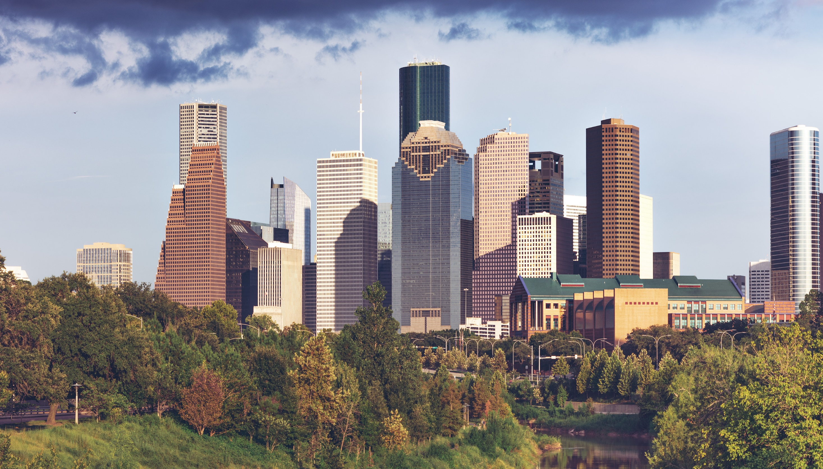
Houston - TX

